Slide 1












Agenda
Our Case
Naming Convention
Tooling
Demo
Other Uses
Building Naming Refactoring
tool for Power Apps
Open
Share
With YAML, VSCode and Python Script
Notes:
Thank u all for coming... Welcome to Building Naming Refactoring tool for Power Apps with YAML, VSCode and Python Script This is our agenda...

Slide 2









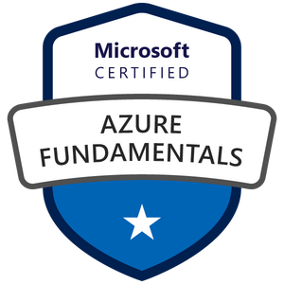
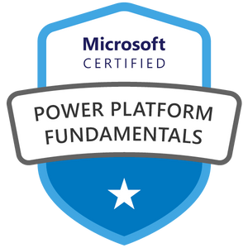
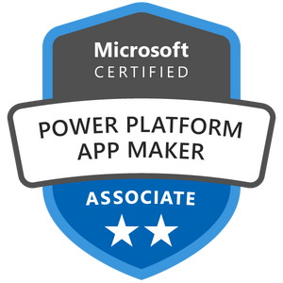


Jean Paul Dosher
Power Platform developer at
Former electrical engineer
13 years of experience in the automotive industry (high precision machining)
Dad of a teenager and 10 cats
Go to Certifications
Jean Paul Dosher
MS Certifications
Notes:
[Ler Slide] So, ye, who Am I: My name is Jean Paul Dosher. Before I got into tech, I spent over 13 years working as an electrical engineer in the automotive industry, specifically in high-precision machining. Now, I’m a Power Platform Developer at Nexer EA Brazil. Also dad of teenager and 10 cats

Slide 3


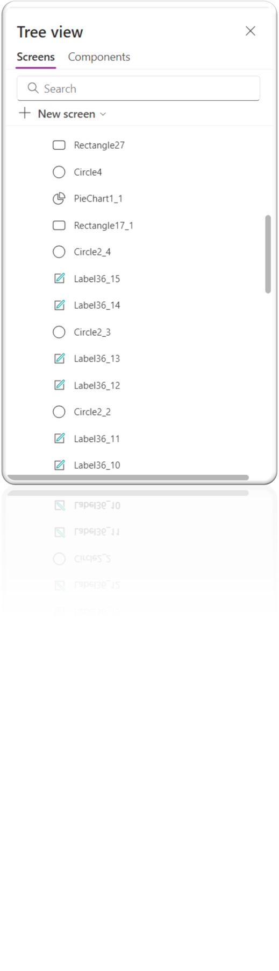
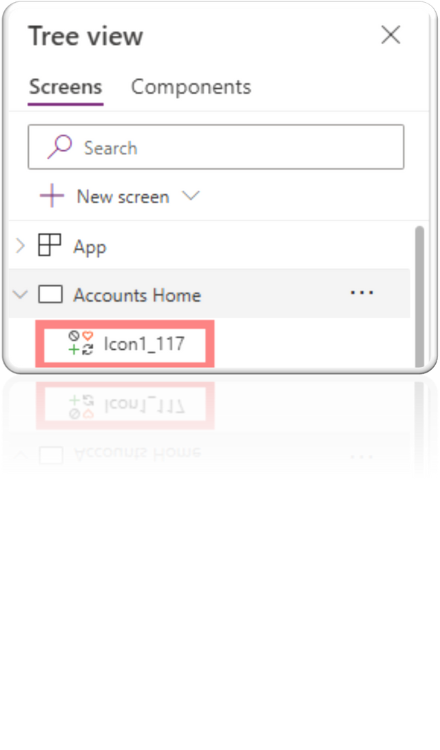
Lots of Controls to rename
Notes:
We got into a “legacy” Power App System with low level of development maturity, Where the last developers replyed controls like there is no tomorrow.... Some controls got replicated one hundred times.... Well, we deffinetly wanted to rebuild the app from scratch, but that was not possible due time consumption and some Project aspects
But, how do we quote on quote “Discover the legacy the APP” ? [next slide]

Slide 4

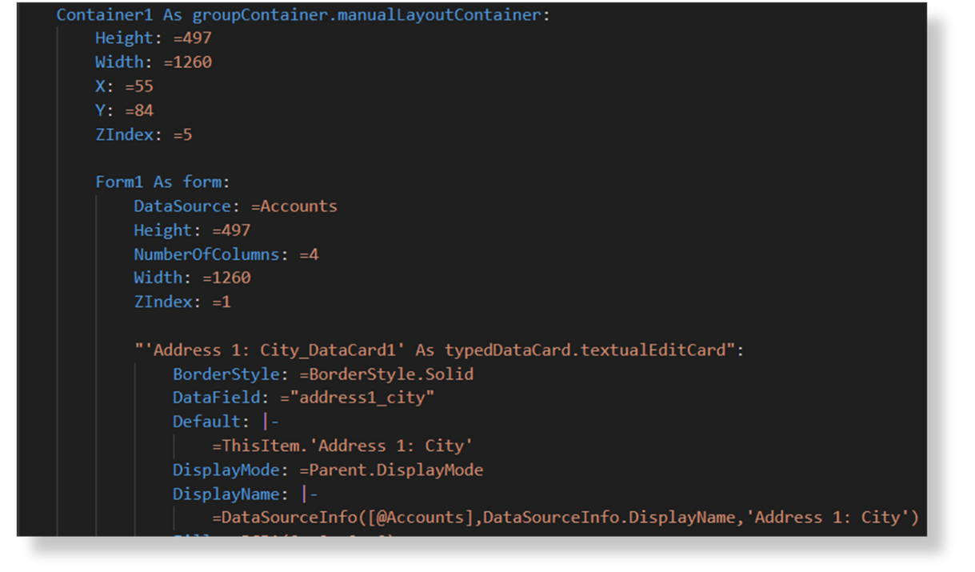
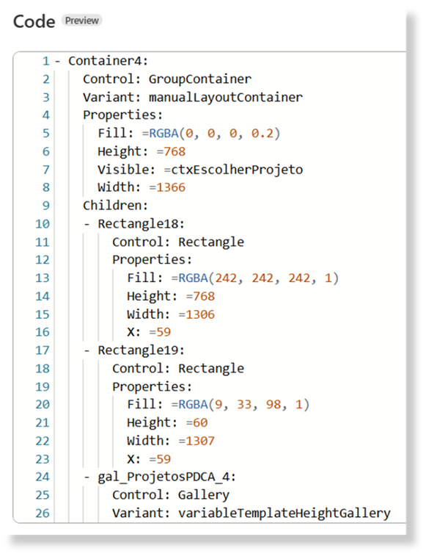
Naming Conventions and YAML
{ {control type prefix}_{context/purpose}_{container}_{screen}
Notes:
Here is Where YAML and Power Apps tooling comes to save! So, this is our goal for the refactored Control, its based in Mathew Devaney`s naming conventions with adition of {container}. You guys have played a lot with Code view preview feature in Power Apps Studio, rigth? The code structure that we will use is from the unpacked MSAPP, it’s a bit diferent from code preview, you`ll see it later in details. But, long story short, we’ve a bit different schemma. So, YAML has this great structure that allows us to context things (like the “As”, the indentation, the proprieties inside of it), the main ideia here is to get context for each control... We’ll see that, hold on

Slide 5




Tooling
Power Apps-Tooling
GitHub Repo
C#/.Net lib. for working with msapp files
🐍Python Script/Algorithm
Open
Share
Get screen name
Check Hierarchy and save
Check if changes are possible (duplicate?)
Check Control type (i.e: as Label)
Extract Context from Tooltips and Texts
Change if necessary
Save old and new names
Recheck to identify references to the modified control in other controls
Power Platform Tools
for VSCode
Power Platform CLI (aka pac) available in your VSCode terminal
Open
Share
Continue
Notes:
For tooling i’ve essentially used Power Platform tools, and the Power Apps-tooling (that is inside Power Platform extension).... And about the python script: I’ve tried some YAML lib and even LLM’s, but have any sucess...So i decide to keep things simple and treat YAML as text, so here is the steps of the refactoring algorithm....
[OPEN THE Example.fx in VSCODE]

Slide 6



Demonstration
🤖Refactoring steps
Download "legacy" app
to unpack: pac canvas unpack --msapp YourAppName.msapp --sources DestinyFolder
Copy Screen to python dist
Run Renaming tool
Use compare tool in VSCODE
Rename the APP in CanvasManifest.json
to pack: pac canvas pack --msapp YourAppName.msapp --sources DestinyFolder
Import app in Apps Page
Continue

Slide 7

💡Room to Grow
Embedded pack/unpack in a user-friendly C# app or
Add to your DevOps procedures
Use LLM’s?
Perhaps deepest refactoring
Continue
Notes:
Well, that was a simple application for the specific problem that I had –but it can envolve as mucas as your imagination allows... [read] But be carrefull, the CLI pack/unpack is in Preview and YAML Schemas may change

Slide 8






Thanks!
Keep in Touch!
linkedin.com/in/jean-paul-dosher
medium.com/@jean.dosher
jean.dosher@nexergroup.com
jpdosher@hotmail.com

